Slide 1
Welcome to TACC
Charlie Dey
charlie@tacc.utexas.edu
Susan Lindsey slindsey@tacc.utexas.edu

Slide 2
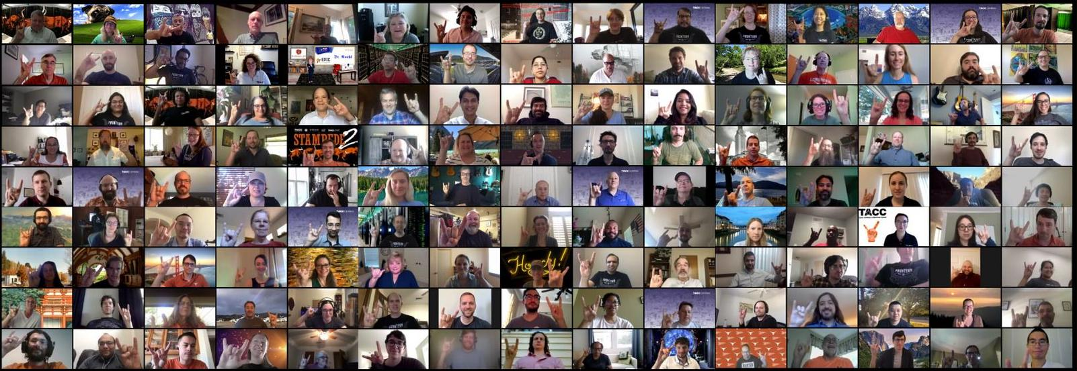
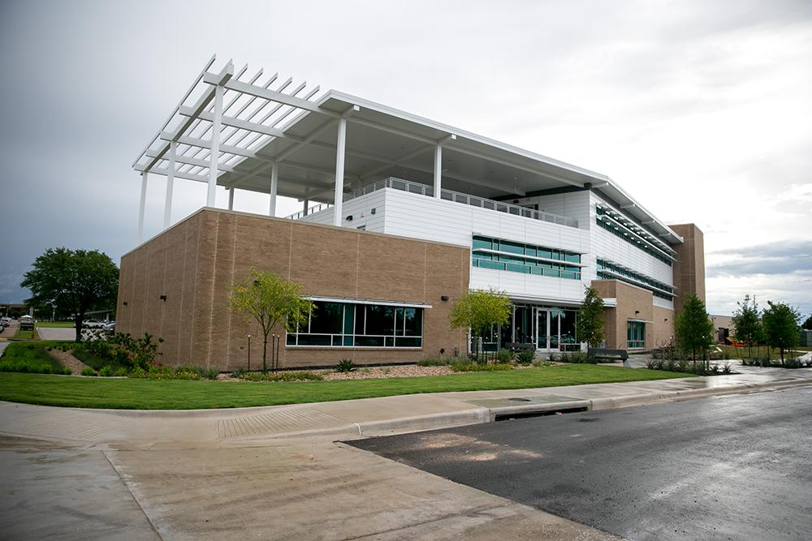
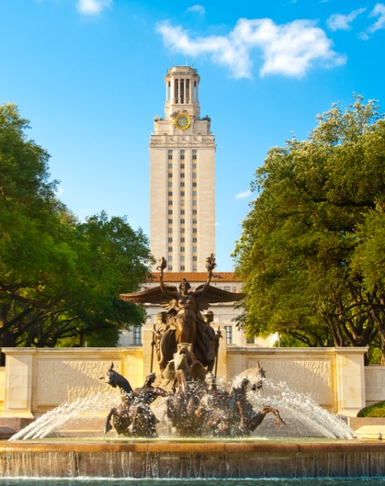
TACC AT A GLANCE
Research center located at UT Austin
~200 Staff (~70 PhD scientists, ~20 students)
Funded by UT System, NSF (85% external grants)
Users: >10,000 on 2,300 active projects across all fields
Partnerships: UT Research Cyberinfrastructure (UTRC), Once known as Extreme Science and Engineering Discovery Environment (ACCESS-CI), Industry, International
Mission: “To enable discoveries that advance science and society through the application of advanced computing technologies.”

Slide 3
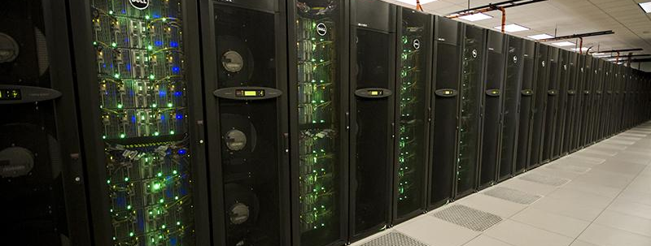
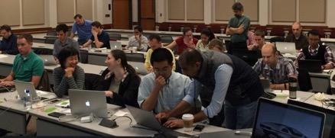
TACC AT A GLANCE
Capacity and Infrastructure:
A billion compute hours per year
>5 billion files, >50 petabytes of data
Hundreds of public datasets
18 MW data center
Systems and Services:
High performance computing (HPC), high throughput computing (HTC), large scale data storage, cloud computing, visualization
Portals and gateways, web service APIs, rich software stacks
Consulting, curation and analysis, code optimization, training and outreach

Slide 4
"COMPUTING FOR THE ENDLESS FRONTIER"
Dan Stanzione
Executive Director, Texas Advanced Computing Center
Associate Vice President for Research, The University of Texas at Austin

Slide 5
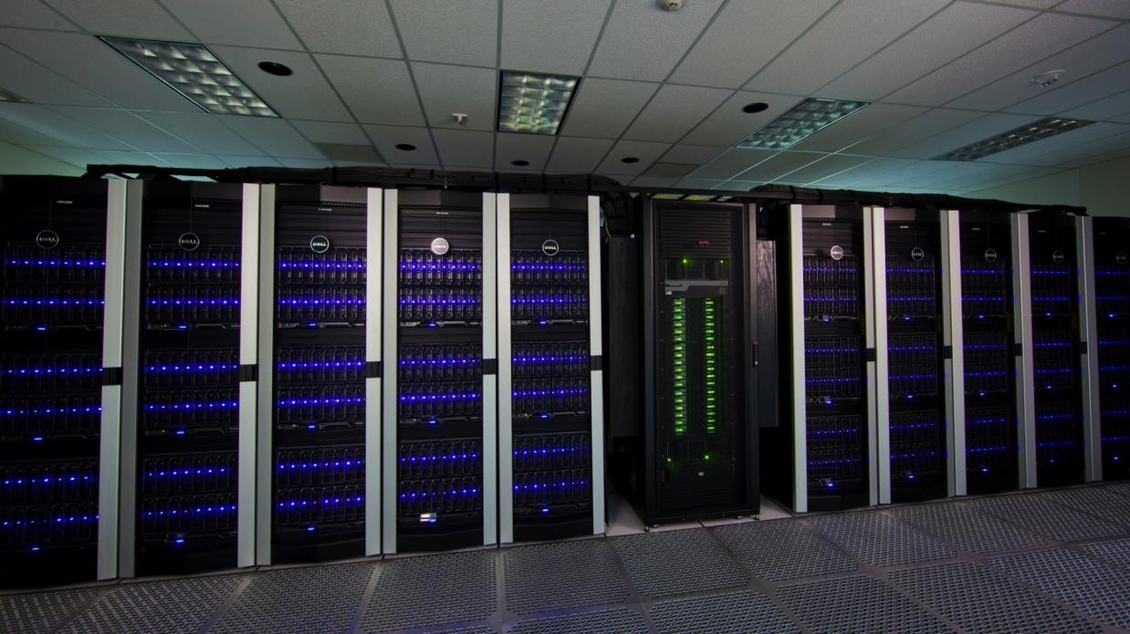
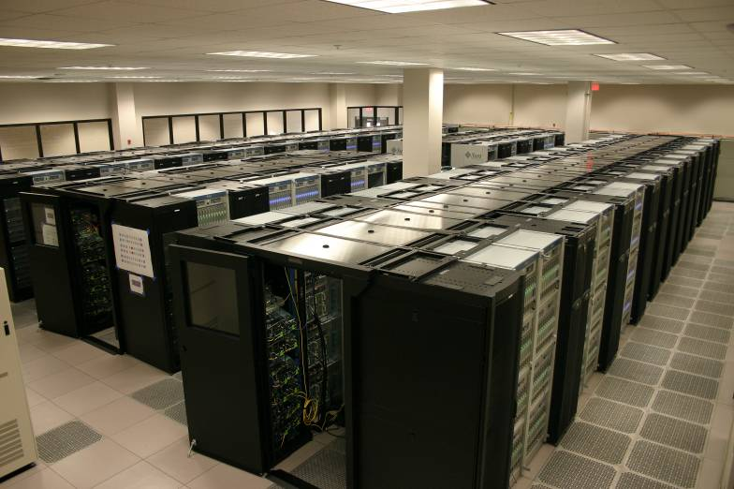
RAPID GROWTH FROM THEN TO NOW…
2003 – First Terascale Linux cluster for open science (#26)
2004 – NSF funding to join the Teragrid
2006 – UT System Partnership to provide Lonestar-3 (#12)
2007 - $59M NSF award – largest in UT history – to deploy Ranger, the world’s largest open system (#4)
2008 – funding for new Vis software and launch of revamped visualization lab.
2009 - $50M iPlant Collaborative award (largest NSF bioinformatics award) moves a major component to TACC, life sciences group launched.
In 2009, we reached, 65 employees.

Slide 6
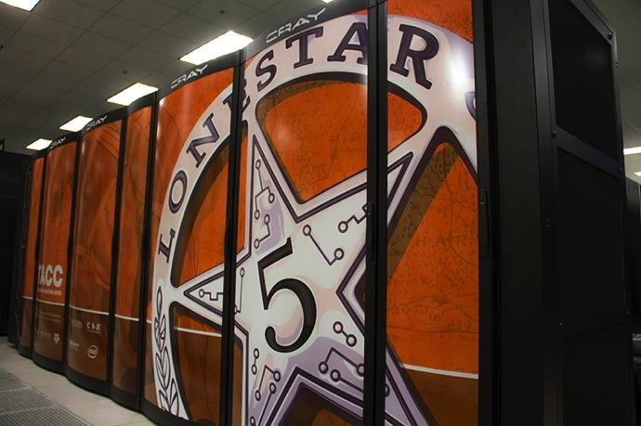
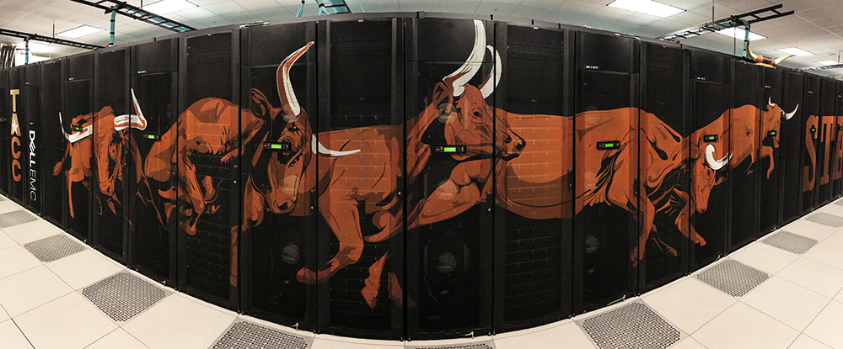
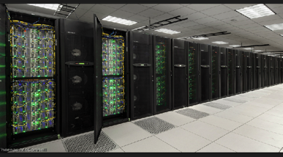
NOW, A WORLD LEADER IN CYBERINFRASTRUCTURE
2010, TACC becomes a core partner (1 of 4) in XSEDE, the TeraGrid Replacement
2012, Stampede replaces Ranger with new $51.5M NSF Award
2013, iPlant is renewed, expanded to $100M
2015, Wrangler, first data intensive supercomputer is deployed.
2015, Chameleon cloud is launched
2015, DesignSafe, the cyberinfrastructure for natural hazard engineering, is launched.
2016 Stampede-2 awarded the largest academic system in the United States, 2017-2021.

Slide 7

FRONTERA SYSTEM --- HARDWARE
33rd (June 2024) Fastest Supercomputer in the world
#1 for Open Science
Primary compute system: DellEMC and Intel
35-40 PetaFlops Peak Performance (Next Generation Xeon processors)
Interconnect: Mellanox HDR and HDR-100 links.
Fat Tree topology, 200Gb/s links between switches.
Storage: DataDirect Networks
50+ PB disk, 3PB of Flash, 1.5TB/sec peak I/O rate.
Single Precision Compute Subsystem: Nvidia
Front end for data movers, workflow, API

Slide 8
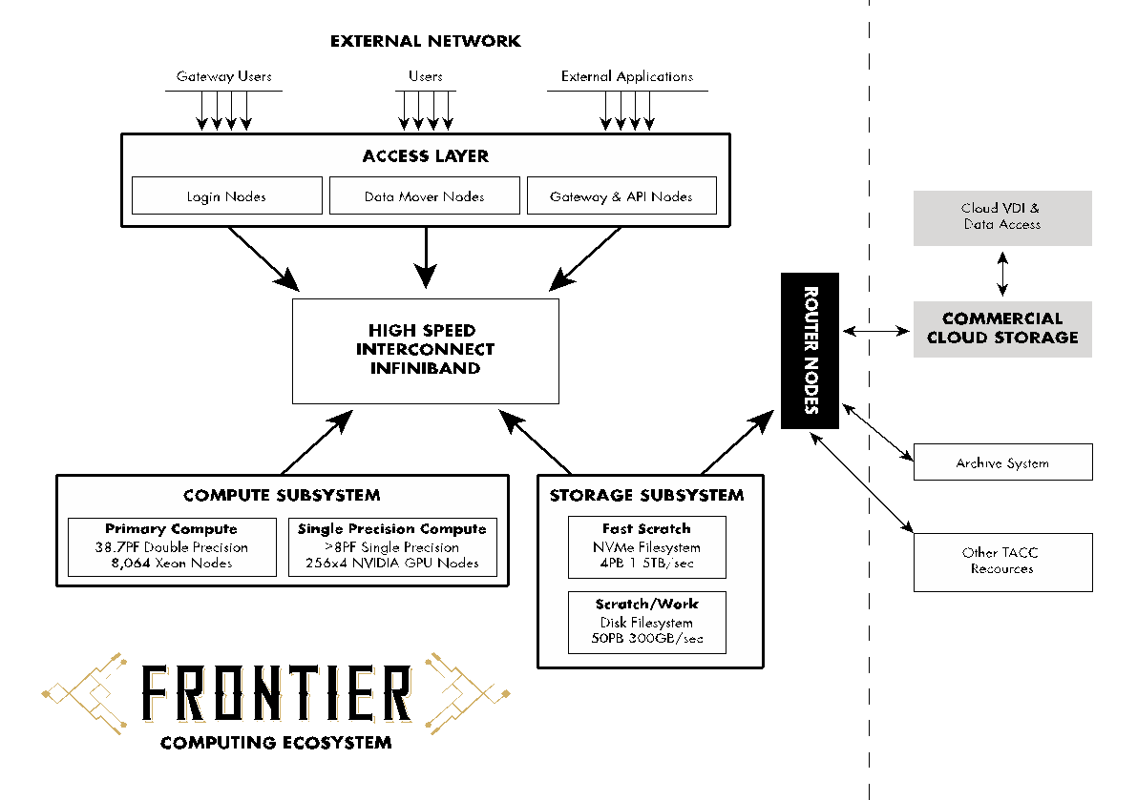
SYSTEM OVERVIEW
>38PF Dbl Precision
>8,000 Xeon Nodes
>8PF Single Precision

Slide 9
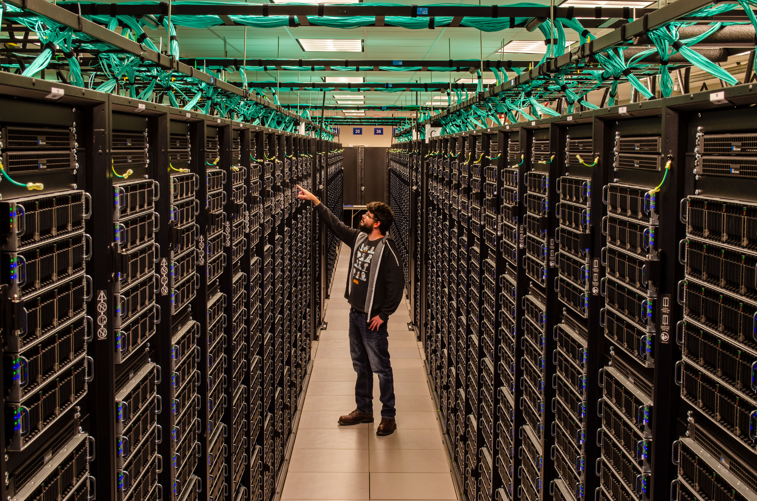

Slide 10
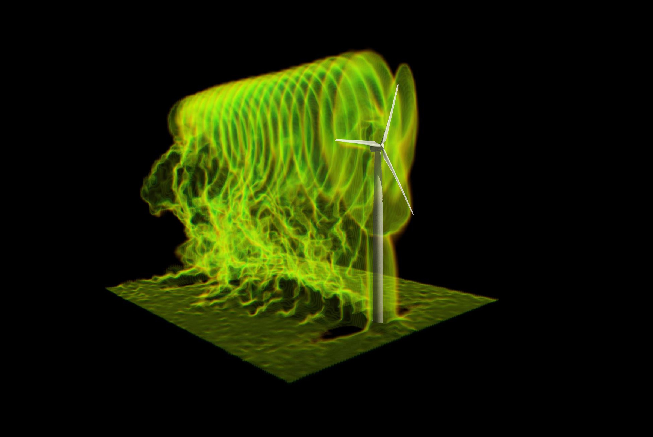
REAPING POWER FROM WIND FARMS
Multi-Scale Model of Wind Turbines
Optimized control algorithm improves design choices
New high-res models add nacelle and tower effects
Blind comparisons to wind tunnel data demonstrate dramatic improvements in accuracy
Potential to increase power by 6-7% ($600m/yr nationwide)
“TACC...give[s] us a competitive advantage…”
Graphic from Wind Energy, 2017.
Christian Santoni, Kenneth Carrasquillo,
Isnardo Arenas‐Navarro, and Stefano Leonardi
UT Dallas, US/European collaboration (UTRC, NSF-PIRE 1243482)
TACC Press Release
Notes:
Xxxxx Speaking notes here xxxxx

Slide 11
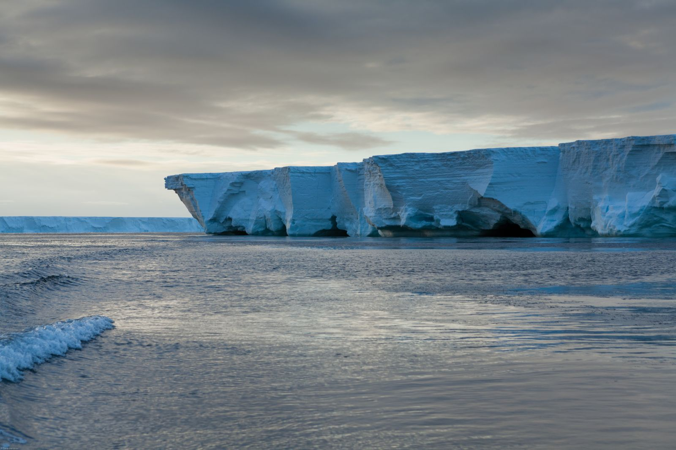
MASSIVE DATA SET WORTHY OF ROSS ICE SHELF ITSELF
Graphic here.
frame.
TACC partners with Lamont-Doherty Earth Observatory (LDEO) to host for one of the country’s largest earth sciences data collections
Managing hundreds of TB using Stampede2, Corral, and Ranch: storage, provenance, visualization, and public access
Achieved 10x workflow speedup by moving to TACC (from 50 hrs down to 5 hrs for transfer and analysis tasks)
“...partnership...with TACC shows [it’s] possible to manage…this level of data in a cost-effective, user-friendly and easily accessible manner…”
Image courtesy Oceanwide Expeditions.
TACC Press Release
PI Lingling Dong, Columbia University
XSEDE support to multidisciplinary, multi-institutional Rosetta project
Notes:
Xxxxx Speaking notes here xxxxx

Slide 12
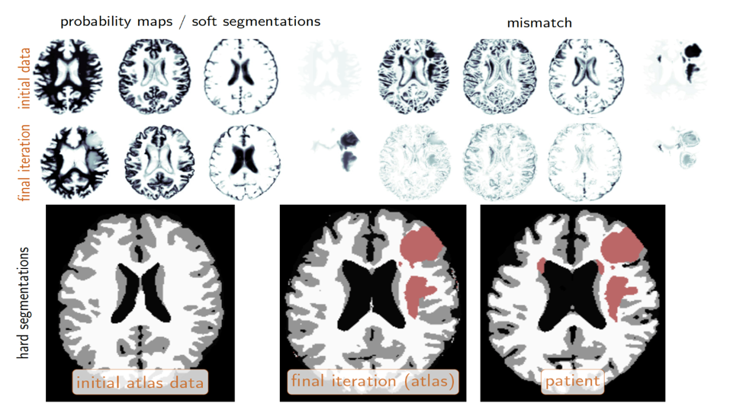

Slide 13
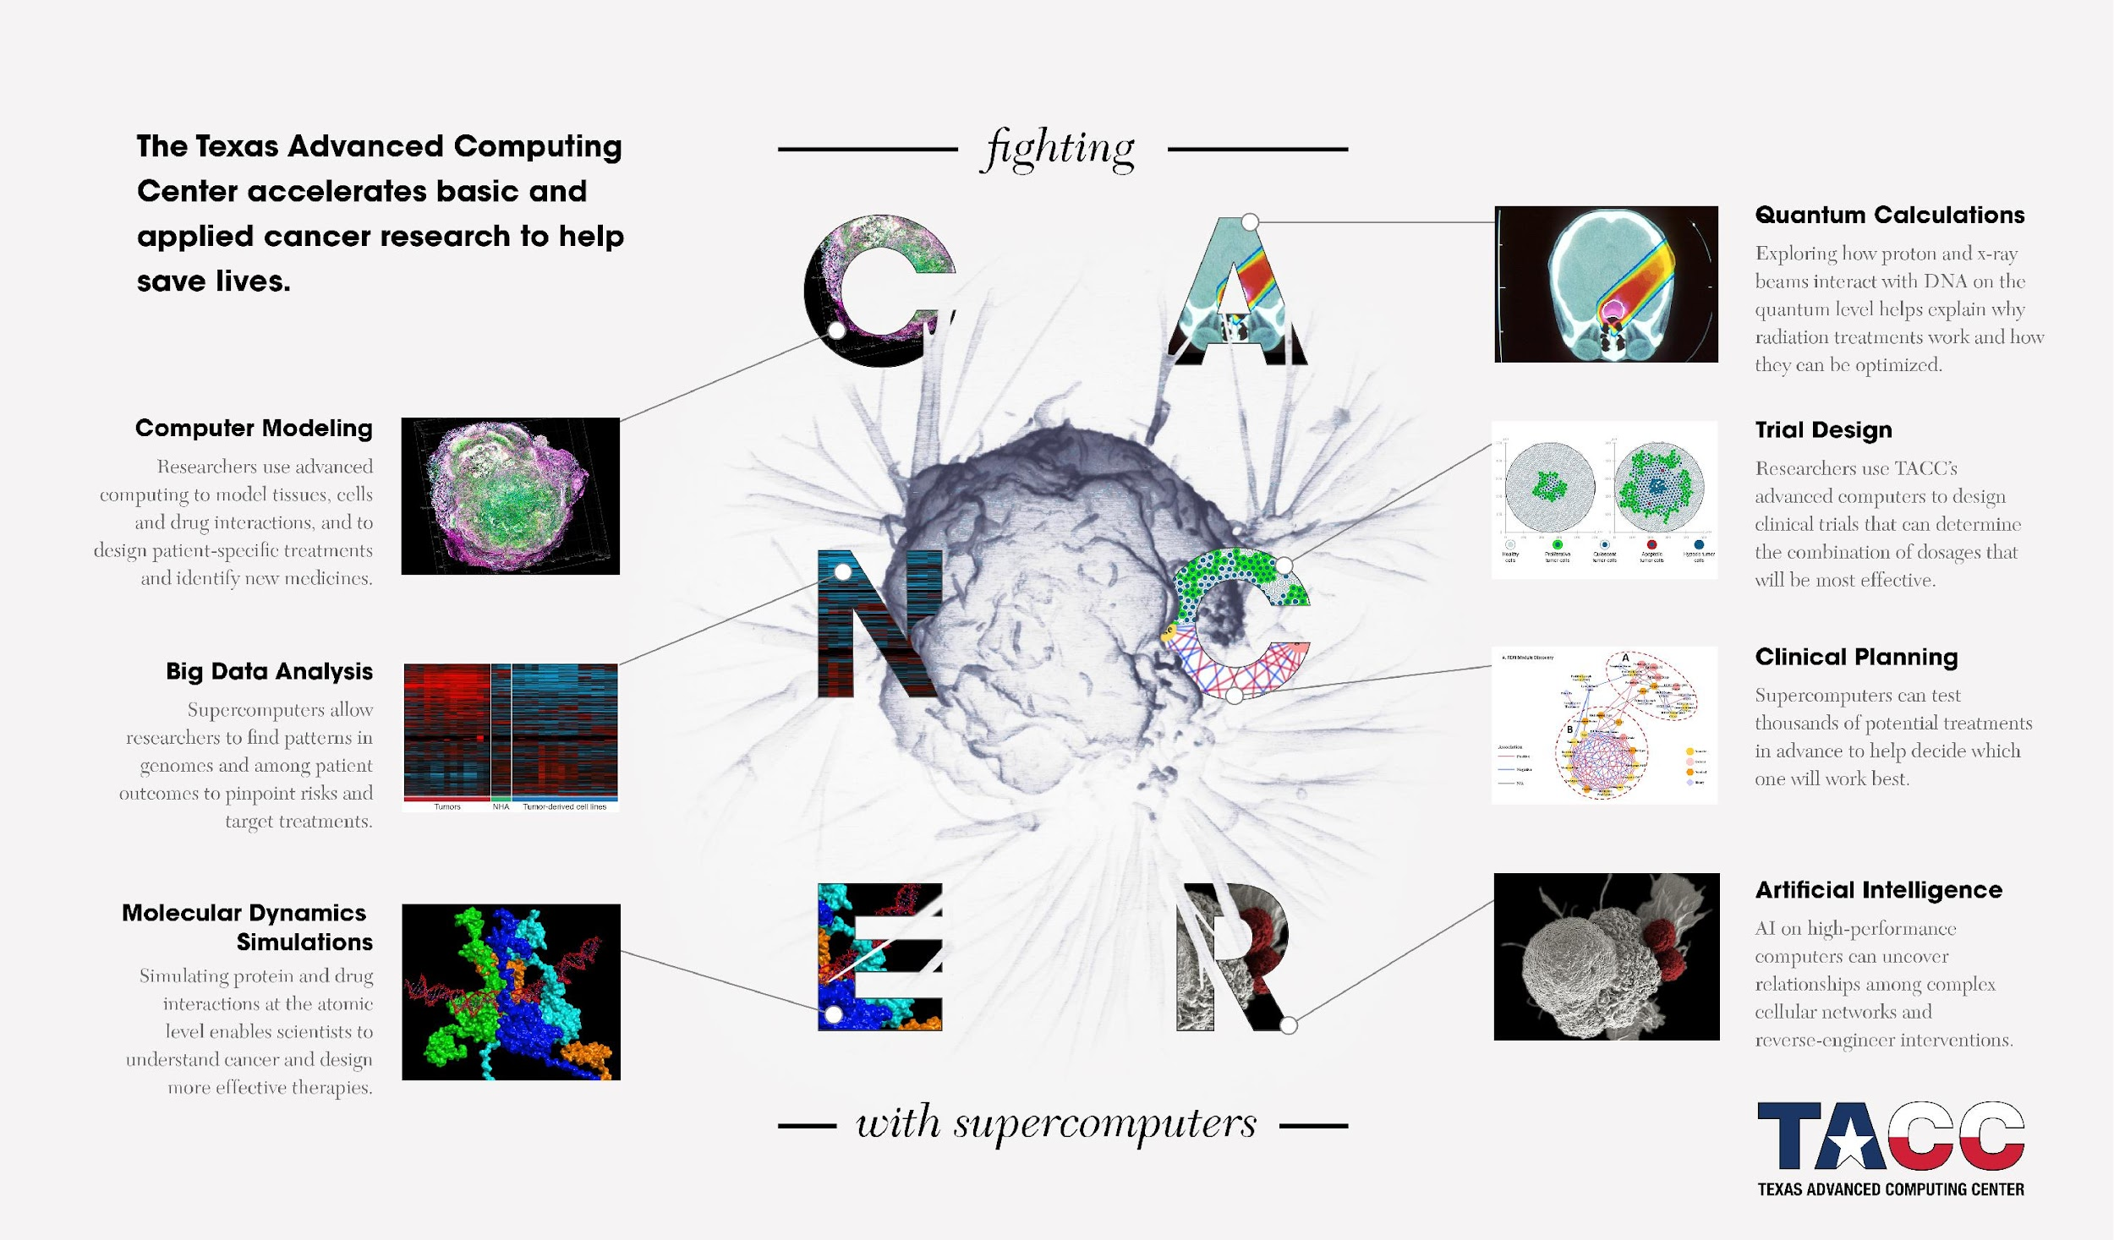

Slide 14
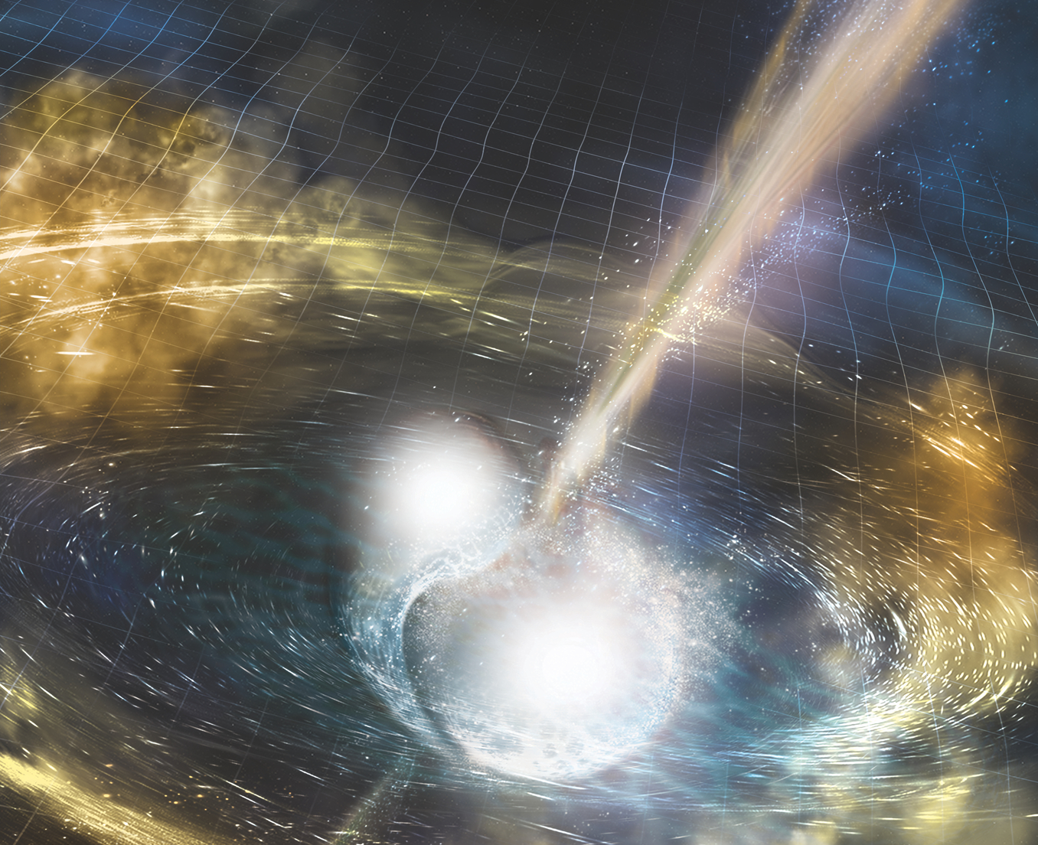
The Laser Interferometer Gravitational-Wave Observatory (LIGO)
waves.
TACC provided consulting services to LIGO researchers, 10x improvement in runtime
seven million core hours on Stampede to help analyze the first detected gravitational
"Stampede was an excellent tool for improving our understanding of the universe we live in, from the smallest scale of sub-atomic particles to detecting gravitational waves that have traveled a million light-years to the earth, and a lot of exciting science and engineering in between"
Stuart Anderson, Caltech LIGO Research Manager

Slide 15
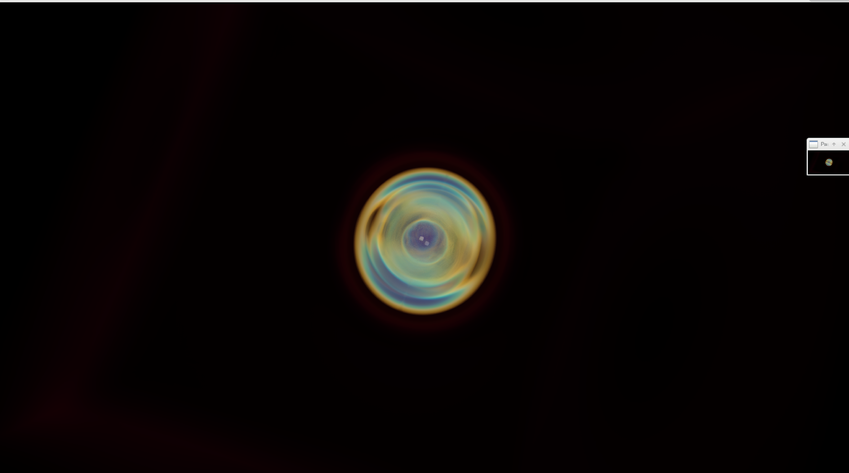
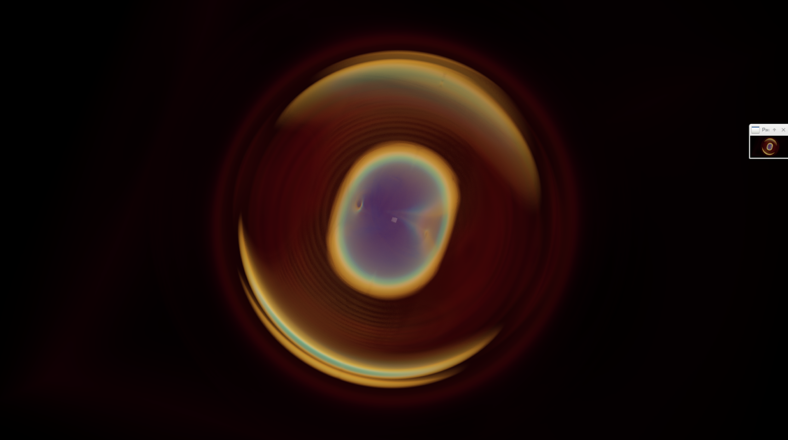
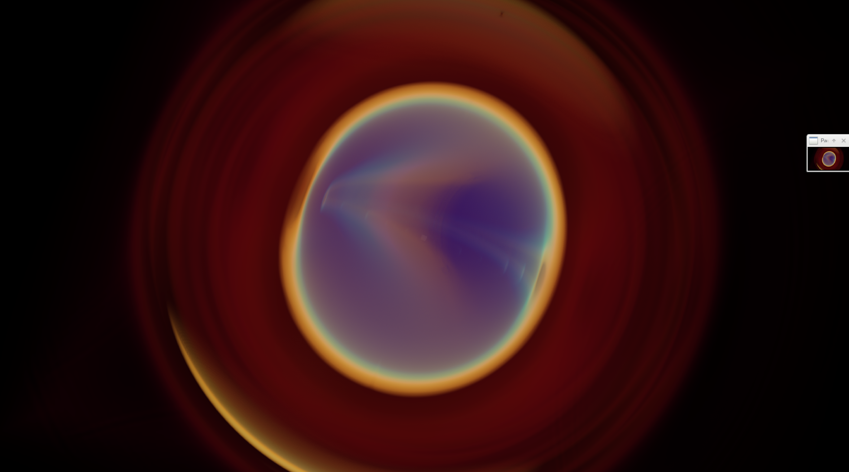
COSMOS GRAVITATIONAL WAVES STUDY
Image Credits:
Greg Abram – TACC
Francesca Samsel – CAT
Carson Brownlee - Intel
Markus Kunesch, Juha Jäykkä, Pau Figueras, Paul Shellard
Center for Theoretical Cosmology, University of Cambridge

Slide 16
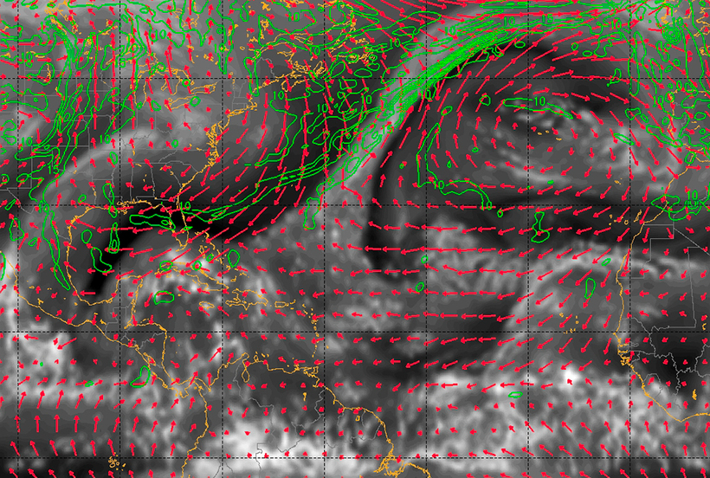
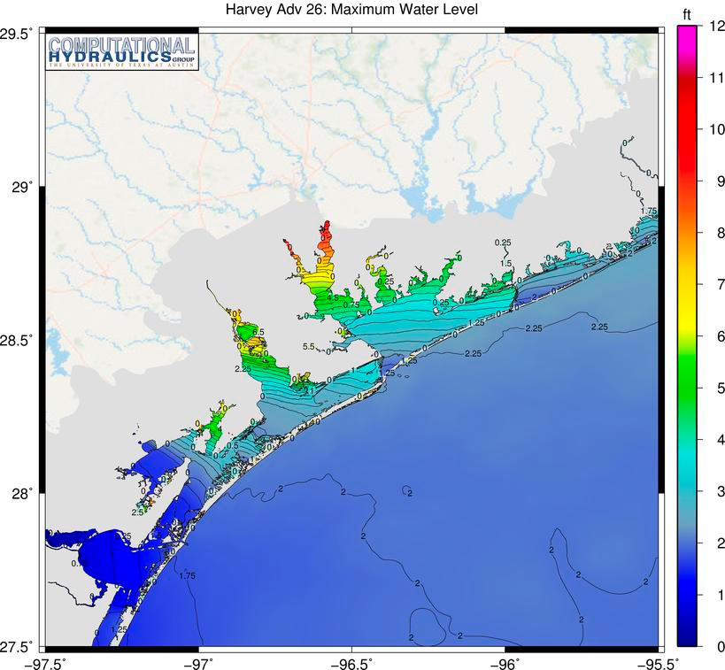
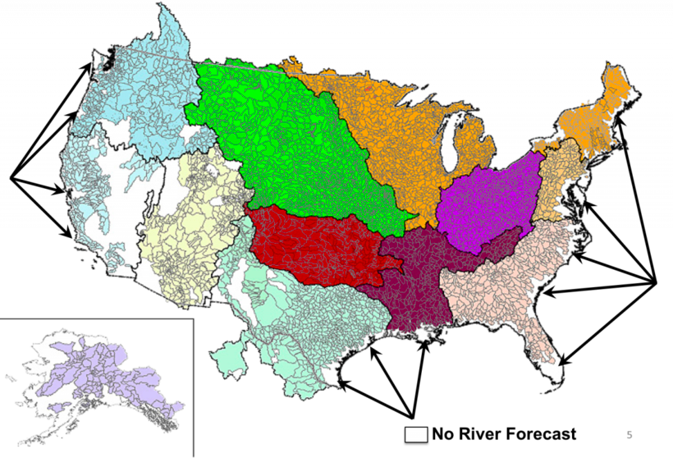
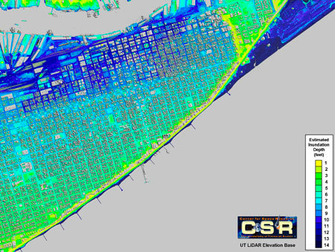
HARVEY
Next Generation Storm Forecasting (with Penn State)
Storm Surge Modeling (with Clint Dawson UT Austin)
Preliminary river flooding and inundation maps (David Maidment UT Austin)
Remote Image Integration and Assimilation (Center for Space Research, UT Austin)

Slide 17
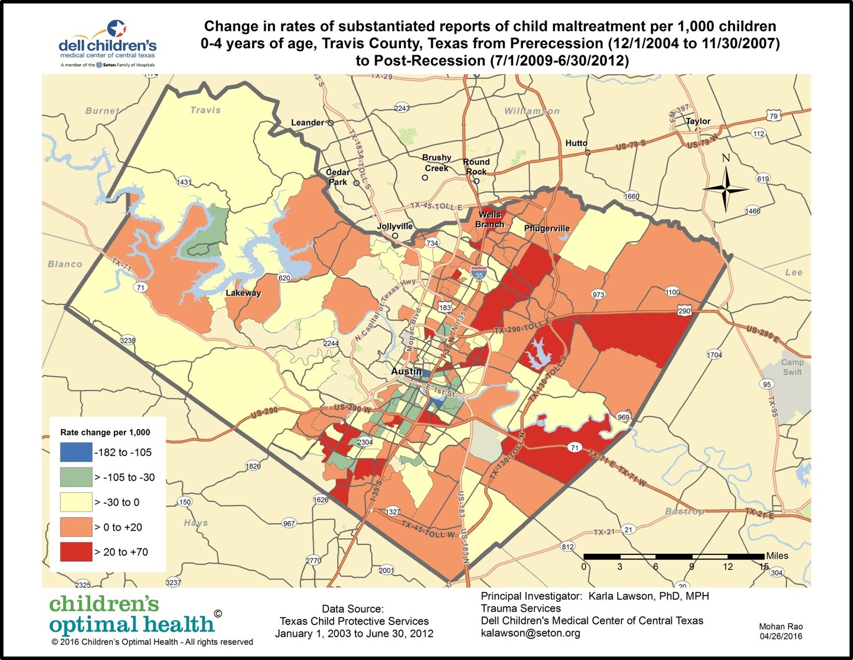
IMPROVE CHILD WELFARE THROUGH ADVANCED COMPUTING
The Texas Advanced Computing Center (TACC) at The University of Texas at Austin has teamed up with Austin, Texas-based non-profit Children's Optimal Health (COH) to provide the technical infrastructure needed to help solve issues in children's health and education throughout Central Texas, including disease, mental health and adverse childhood experiences.
Notes:
Movement is one of the most complex types of information to interpret. With hundreds of joints and limbs interacting simultaneously and a person's imagination, there are countless ways in which the body can move. The first prototype of Movement Style Machine is WalkNet that is currently trained for locomotion (walking), but there is no limit to any particular movement in principle.
https://www.tacc.utexas.edu/-/a-dance-with-algorithms

Slide 18
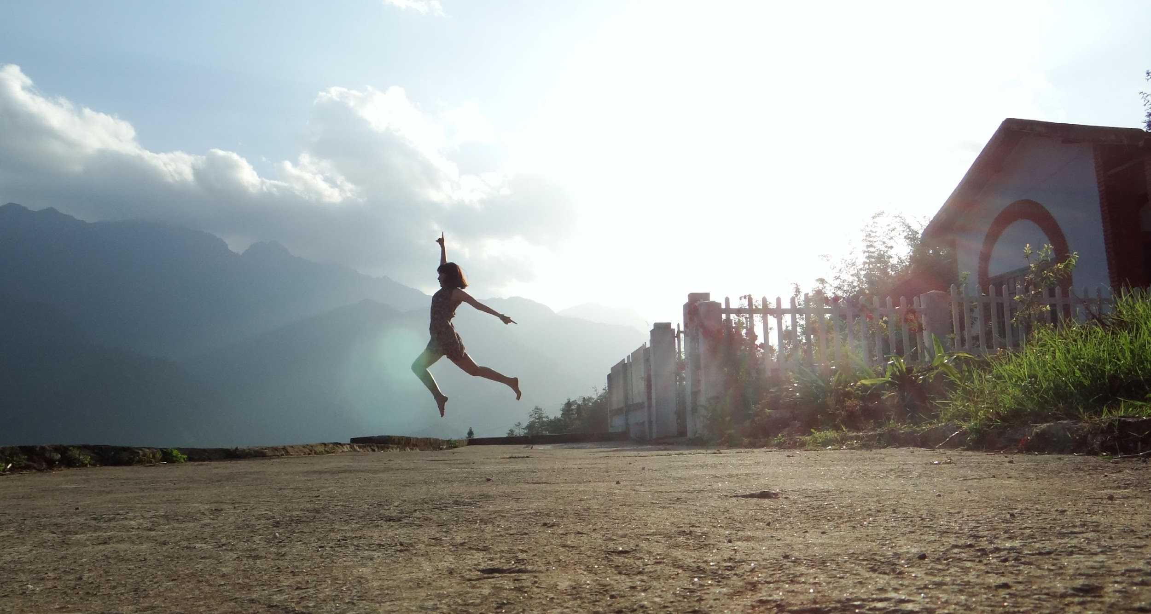
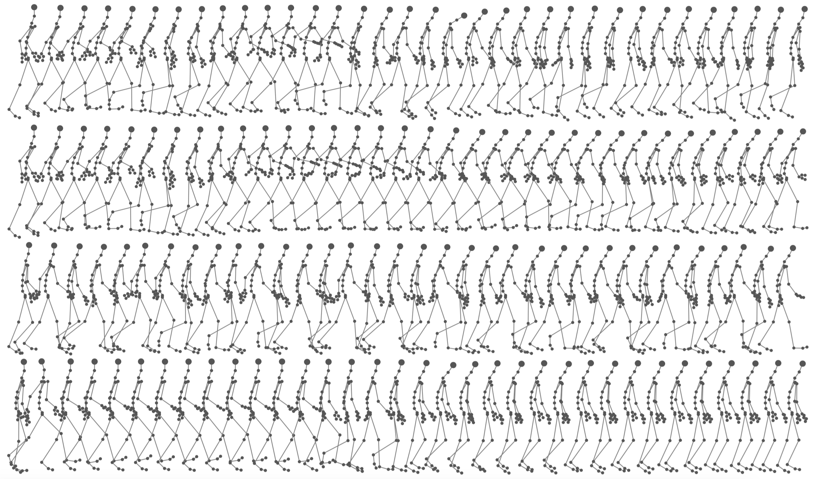
A DANCE WITH ALGORITHMS
XSEDE resources help researchers merge art and science to create systems that can understand and produce human-quality movement
Uses deep learning techniques and relies on the collaboration of graduate students with artists to create new algorithms
On a single computer, running our algorithms would take years, on medium-sized resources months, but using XSEDE, we can train some of most complex models within 24 hours. - Philippe Pasquier, professor and researcher, Simon Fraser University
Notes:
Movement is one of the most complex types of information to interpret. With hundreds of joints and limbs interacting simultaneously and a person's imagination, there are countless ways in which the body can move. The first prototype of Movement Style Machine is WalkNet that is currently trained for locomotion (walking), but there is no limit to any particular movement in principle.
https://www.tacc.utexas.edu/-/a-dance-with-algorithms

Slide 19
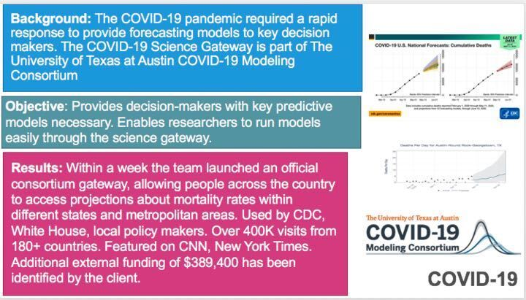
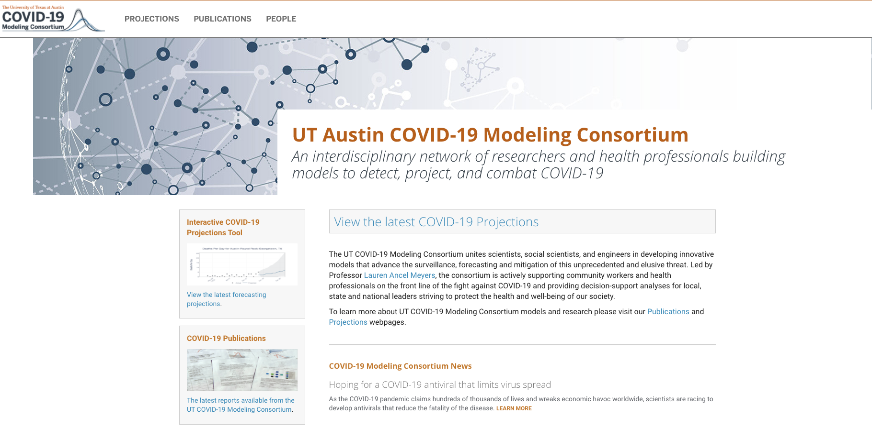

Slide 20
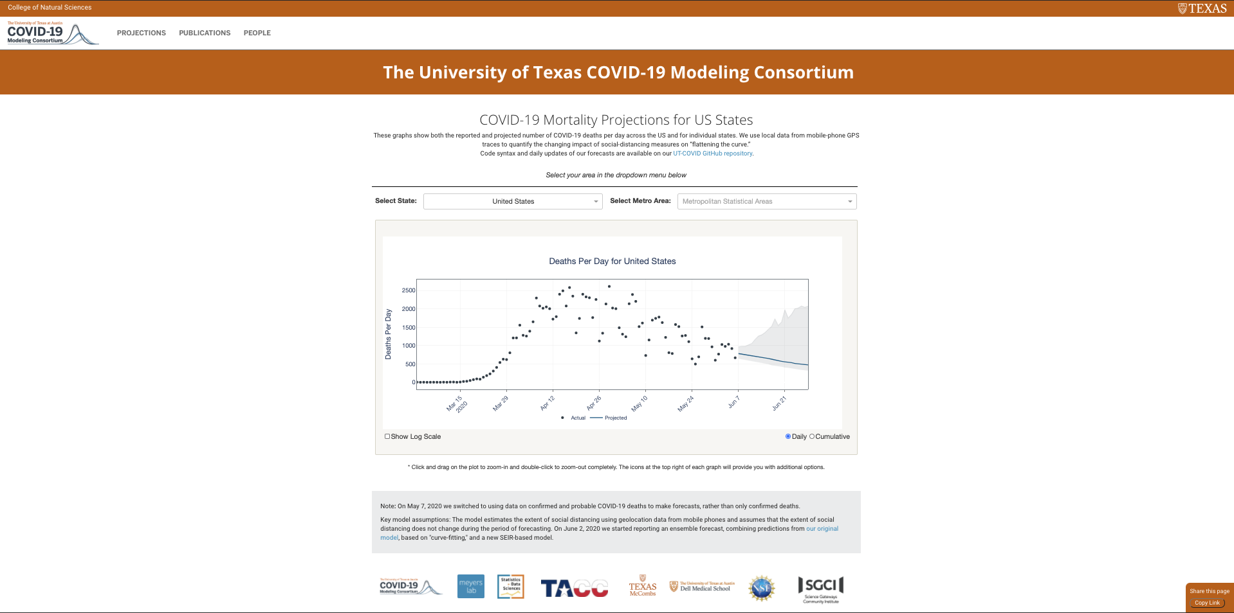
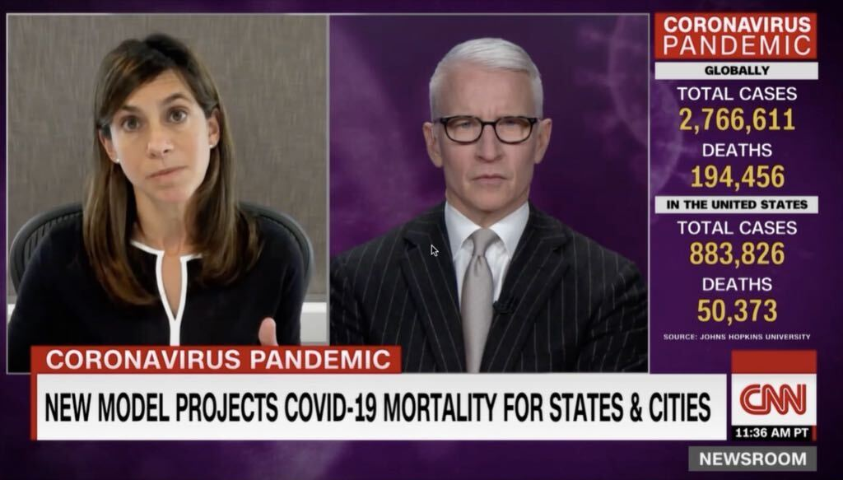

Slide 21
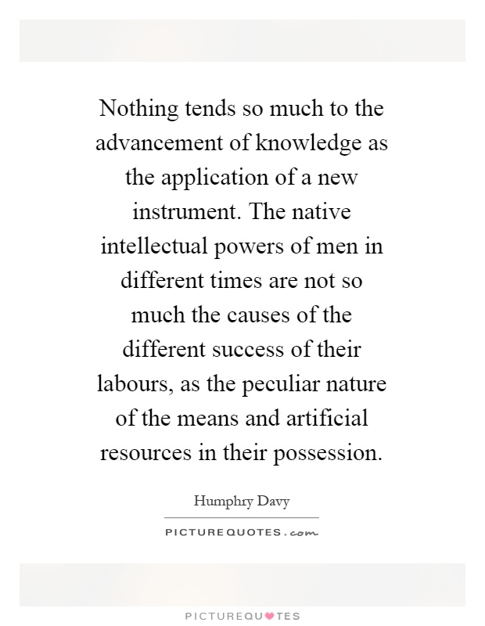
Humphry Davy, Inventor of Electrochemistry, 1812
(Pretty sure he was talking about our machine).

Slide 22
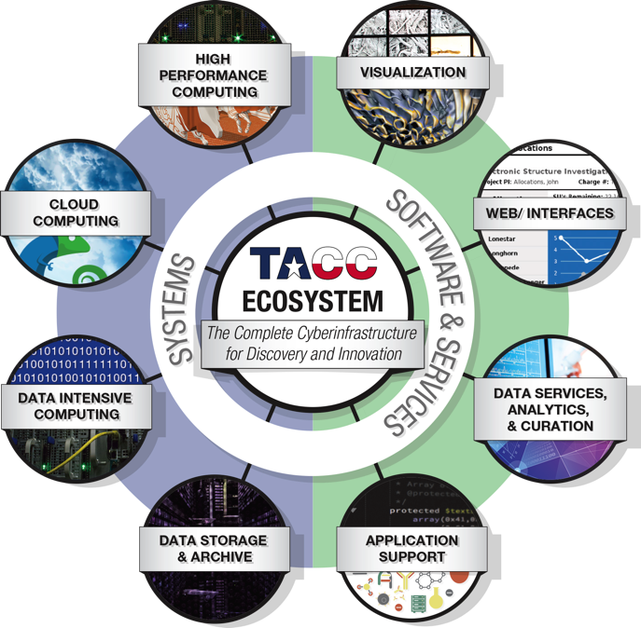
Compute
Collaborate

